Slide 1


Spotify Trends Analysis
Status 05.10.2023
Marianne STEPHANIDES
Merve TASKAYA
Bernhard WEGHAUPT
Tomasz WLODARSKI

Slide 2
Preprocessing Steps
Preprocessing Steps
Genres:
convertion into list
lowercase
remove characters
Tokenization
No „classic“ stoppwords
EDA

Slide 3

Preprocessing Steps
Preprocessing Steps
Lyrics:
Replace ‚\r\n‘ with space
Detect language
Translate lyrics into english (failed so far – filter english songs)
Lowercasing
Remove numbers and punctuation
Tokenization
Removing Stopwords
EDA

Slide 4
EDA
Preprocessing Steps
Statistics for Genres:
Number of Documents: 32589 Average Document Length: 2.68 words Minimum Document Length: 1 words Maximum Document Length: 30 words Vocabulary Size: 2453 unique words
EDA

Slide 5
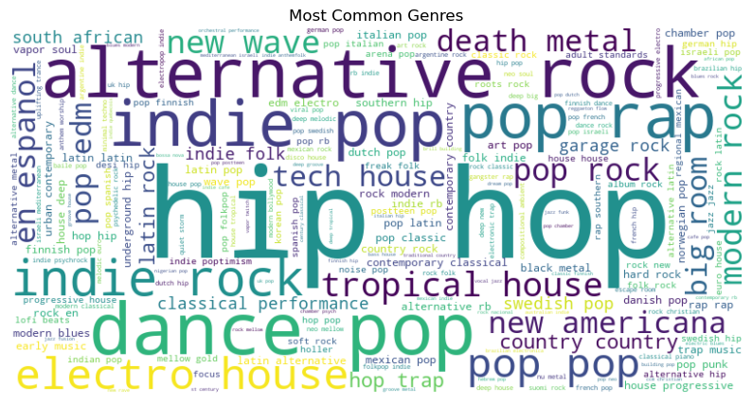
EDA
Preprocessing Steps
EDA

Slide 6
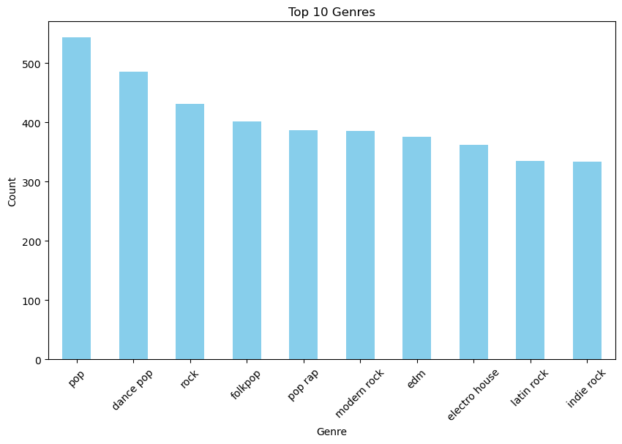
EDA
Preprocessing Steps
EDA

Slide 7
EDA
Preprocessing Steps
Statistics for Lyrics:
Number of Documents: 25728
Total Number of Words: 9950490
Average Document Length: 386.76 words
Minimum Document Length: 2 words
Maximum Document Length: 45398 words
Vocabulary Size: 139469 unique words
Most Common Words: [(',', 514354), ('I', 419661), ('the', 288309), ('you', 260889), ('to', 161731)]
Filtered Words after Stopword Removal: 5675367 words
EDA

Slide 8
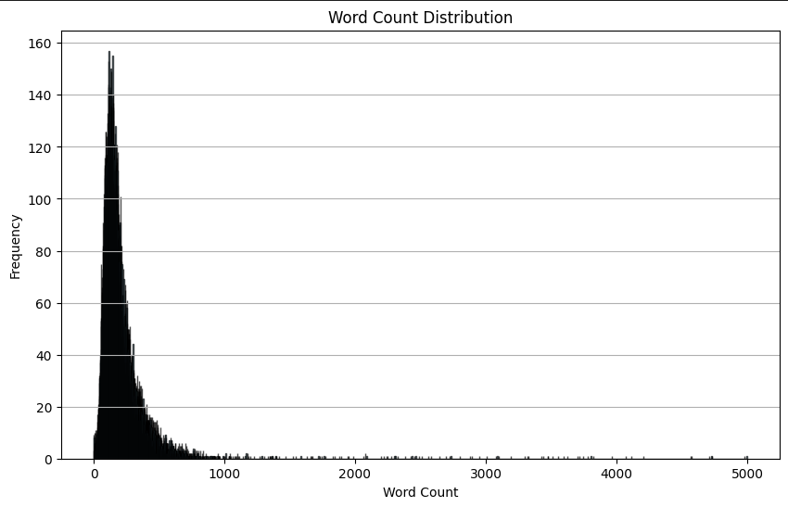
EDA
Preprocessing Steps
EDA

Slide 9
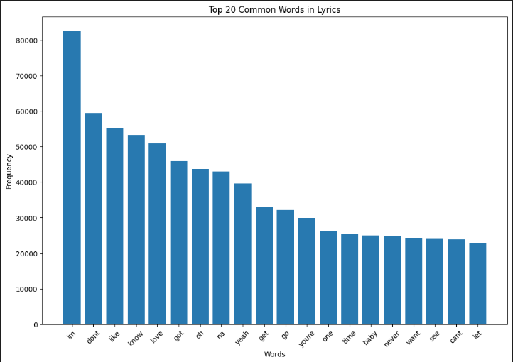
EDA
Preprocessing Steps
EDA

Slide 10
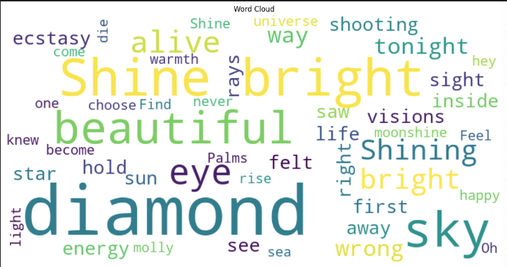
EDA
Preprocessing Steps
EDA

Slide 11

Thank You

